Slide 1
How to drive a car with neural networks

Slide 2
Background
Learn about neural networks through a use case
Write the code from scratch (no libraries)
Interface between biology and programming
Notes:
Through a use-case/project instead of just doing a udemy course
Writing code from scratch (no libraries)
Neural networks draw on interface between biology and programming
TRAIN, don’t PROGRAM – feels like it’s alive

Slide 3
What is a neural network?
Inspired by biology
Made of neurons
Numerical inputs/outputs
Notes:
Mimics structures of human/animal brains

Slide 4
Neuron/ Perceptron
"the embryo of an electronic computer that [the Navy] expects will be able to walk, talk, see, write, reproduce itself and be conscious of its existence."
X1
W1
∑
Activation function
Output
X2
W2
bias
Notes:
Invented in 1958, funded by the United States Navy Research
refined by Minsky and Papert in 1969

Slide 5
Perceptron
X1
W1
∑
Activation function
or ?
Output
X2
W2
bias
y
m = gradient
y = mx + c
c
0
x
Notes:
number of inputs = number of dimensions
Line = decision boundary
Training => changing the weights and bias => moving the decision boundary
Can be RETRAINED without having to be RECODED

Slide 6
Perceptron
AND
OR
 | T | F
T | ✅ | ❌
F | ❌ | ❌
 | T | F
T | ✅ | ✅
F | ✅ | ❌
Notes:
CAN BE RETRAINED
WHY link them together????

Slide 7
Perceptron
XOR Problem
 | T | F
T | ❌ | ✅
F | ✅ | ❌
Notes:
Weights = strength of connections

Slide 8
Perceptron
AND
OR
 | T | F
T | ✅ | ❌
F | ❌ | ❌
 | T | F
T | ✅ | ✅
F | ✅ | ❌
 | T | F
T | ❌ | ✅
F | ✅ | ❌
XOR
Notes:
Weights = strength of connections

Slide 9
Linking perceptrons
Notes:
Weights = strength of connections

Slide 10
Training a Neural Network
Supervised
Trained on labeled data
Example - Identifying labeled images
Unsupervised
Finding patterns
Example - Natural language processing
Reinforcement
Using rewards to encourage behaviour
Example - Genetic algorithms
Notes:
Reinforcement = using a ‘reward’

Slide 11
Genetic Algorithms
Spawn a number of agents
Measure each agent’s “fitness”
Breed the fittest agents
Mutate some of the offspring
Repeat

Slide 12
The challenge
Race a car around a track
Using REAL PHYSICS™️!
Car has 3 inputs:
Acceleration (-1 to +1)
Steering (-1 to +1)
Braking (0 to +1)
Notes:
Real Physics
Momentum, wheel colliders which model grip
more realistic/organic
lends itself to NN rather than more traditional AI approaches
Me driving the car in examples

Slide 13
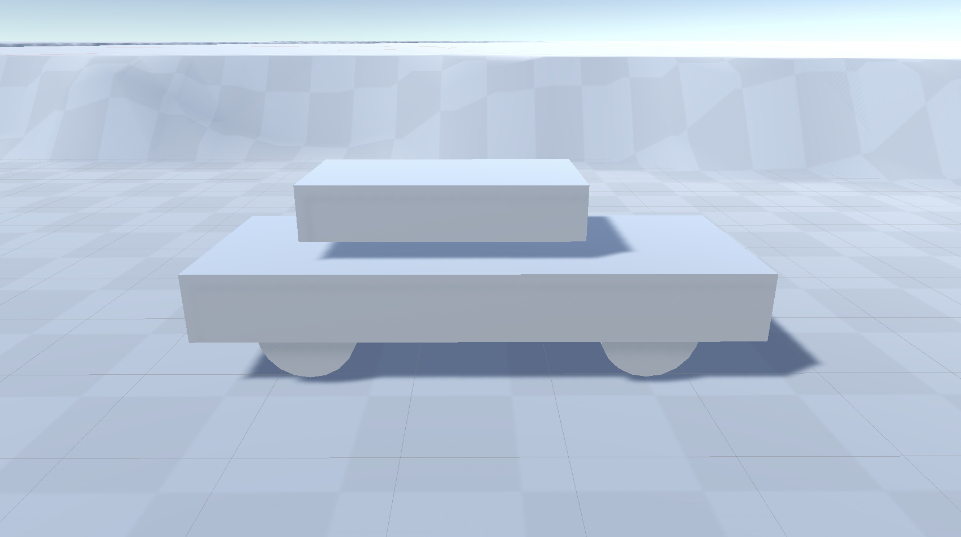
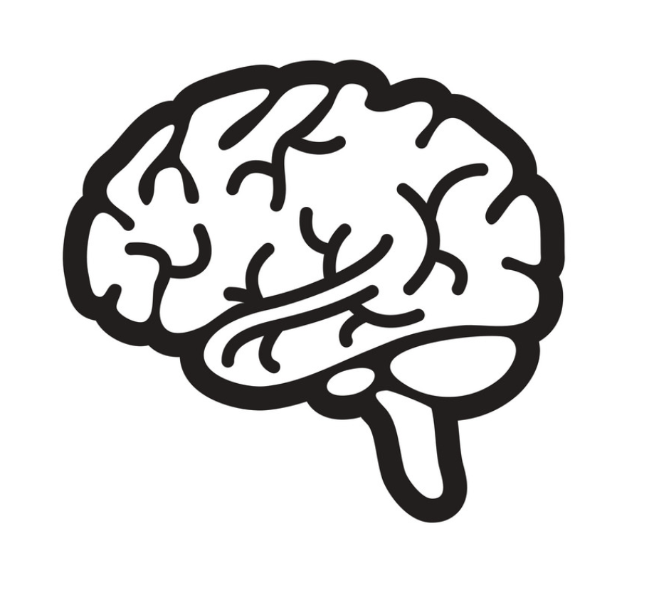
but… how?
👀
Accelerate?
Brake?
Steer?
Notes:
Already have car inputs
What about Brain inputs?

Slide 14
Sensors
Raycasts
Velocity vectors
Angular velocity
Notes:
Also knows the velocity and angular velocity
Makes calculations on each frame

Slide 15
Input layer
Hidden layer
Output layer
Current velocity vector
Current angular velocity vector
Acceleration decision
Proximity to obstacles on ahead
Steering decision
Proximity to obstacles on left
Braking decision
Proximity to obstacles on right
Direction of data flow

Slide 16
DEMO

Slide 17
Genetic Algorithms (again)
Spawn a number of agents
Measure each agent’s “fitness”
Breed the fittest agents
Mutate some of the offspring
Repeat

Slide 18
Fitness
Rewards
Number of gates crossed
Position when crossing
Direction when crossing
… but no penalties? (yet)
Crossing more gates vs crossing them ‘correctly’
Becomes more brute force
Notes:
Fitness – crux of genetic algorithm
Starting

Slide 19
Genetic Algorithms (again)
Spawn a number of agents
Measure each agent’s “fitness”
Breed the fittest agents
Mutate some of the offspring
Repeat

Slide 20
Creating The Next Generation
Previous generation
New generation
(ranked by fitness)
Elites
Offspring
‘Refine’
Mutants of offspring
Mutants of elites
‘Explore’
New genomes
Notes:
Variables – proportions, mutation severity

Slide 21
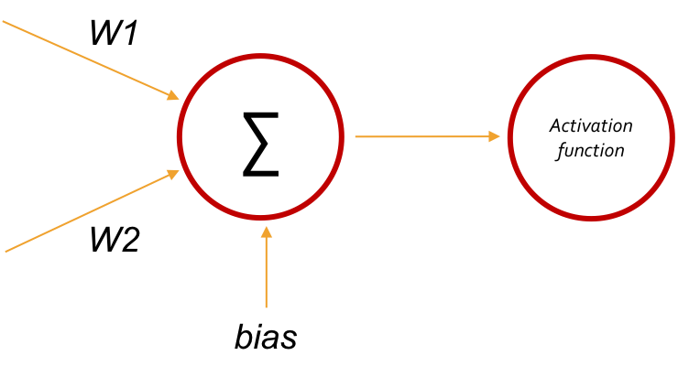
DNA & Chromosomal Crossover
X1
X2
0.45, 0.92, -0.34, 0.63, -0.02, …, 0.53
Parent 1
-0.38, -0.32, 0.77, 0.03, -0.49, …, -0.93
Parent 2
-0.45, -0.32, 0.77, 0.63, -0.02, …, -0.93
Offspring
Notes:
ALSO mutation
Different ways to cross over

Slide 22
Mutation
X1
X2
0.50, 0.92, -0.34, 0.10, -0.02, …, 0.53
0.60, 0.92, -0.34, 0.99, -0.02, …, 0.53
Notes:
ALSO mutation

Slide 23
Fitness over time
1 whole lap completed
~150 generations of smashing into the 4th corner

Slide 24
Evolving the network structure
Input layer
Hidden layers
Output layer

Slide 25
What next?
Evolve more things
Refine fitness calculation
Create training tracks
Try a different training method
Apply it to a different game/context
Notes:
Evolve more things
Activation function
NEAT
The physical car itself
Refine fitness calculation
- Make it less brute force
- Evolving the evolving mechanism itself?
Create training tracks
- Start simple, get more complex, like in real life
Try a different training method
Apply it to a different game/context
- SpaceX

